Slide 1
A* High Level Planning & Replanning

Slide 2
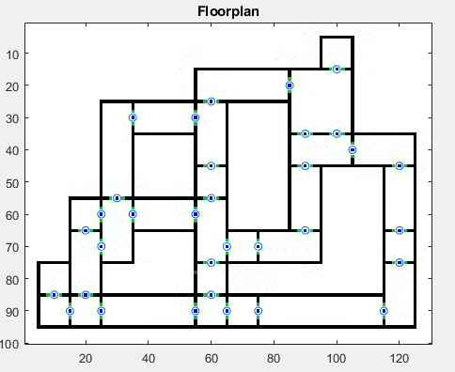
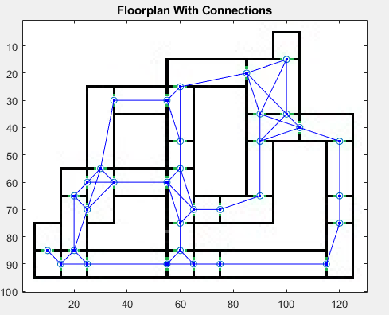
A* Setup
In a Known environment a tree of the portals and their connections can be created such that an A* algorithm can solve the ideal order of rooms/portals to travel from one room to another
Example Floorplan with multiple possible paths to any one destination

Slide 3
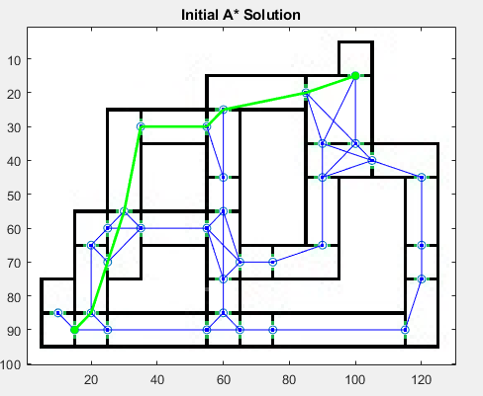
A* Solution
Feeding the tree of connections to an A* algorithm along with start and end points a solution is determined
The initial A* solution starting in the bottom left corner traveling to the top right

Slide 4
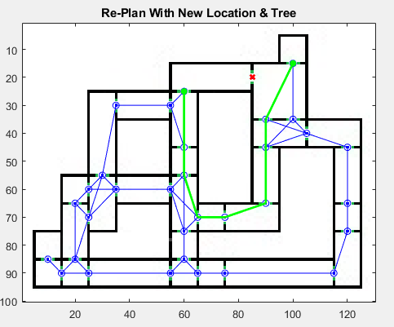
A* Re-Plan
If in the course of traveling along this path we determine that a portal we need to use is blocked we can remove this portal and its connections from the tree and call the A* script once more to achieve a new path from the current location
Initial solution alongside new solution once we have traveled to the room with the previously unknown blockage and determined the need to replan

